Slide 1
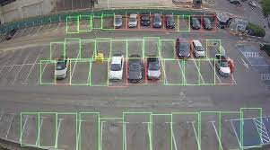
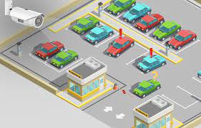
AI in Smart Parking

Slide 2
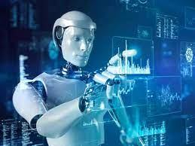
Introduction
As AI is only field which we can apply in each and everything.
So why not in Smart parking that’s why we are here to show you guys our project based on smart parking system using AI.
We have used an Arduino ide for our code part to link that with our model that I have used to make using Proteous platform but now as I am the student of machine learning student I will go further to make it’s physical model as well currently we are facing some issue in that in execution and time not allow us to do that so. So first, I will show how the simulation part looks like in proteous then I will show the code and simulation part. So without wasting more further time let’s begin.

Slide 3
Requirements
LCD display (to check the amount of space is available or not)
Servo motor
IR sensor(for in and out)
Arduino
Arduino ide
Proteous ide

Slide 4
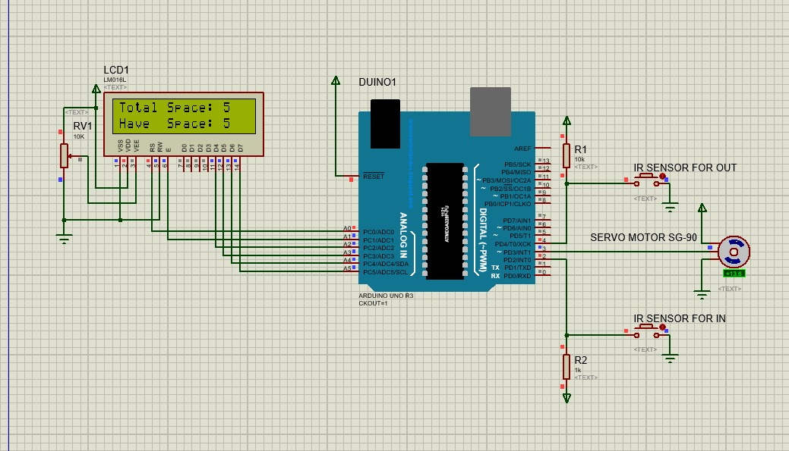

Slide 5
What is Smart Parking System
Smart Parking is an integrated system to organize cars in public areas.
All vehicles enter into the parking and waste time for searching for parking slot.
The motivation of this project is to help drivers and make the payment way easier.

Slide 6
Different applications of AI in Smart Parking
Real-time parking availability: AI algorithms can analyze data collected from sensors and cameras installed in parking lots and on streets to provide real-time information about available parking spaces. This can help drivers save time and reduce frustration by enabling them to quickly find and reserve parking spaces.
Predictive parking: AI can use historical parking data and machine learning algorithms to predict parking availability in specific locations and times of day. This can help drivers plan their trips in advance and avoid areas with high parking demand.
Parking enforcement: AI can be used to detect parking violations and issue tickets automatically. This can improve parking enforcement efficiency and reduce the workload of parking officers.

Slide 7
Different applications of AI in Smart Parking
Parking guidance: AI can guide drivers to available parking spaces using digital signs and mobile apps. This can reduce traffic congestion and help drivers save time and fuel.
Payment systems: AI can automate payment systems and reduce the need for human interaction. This can improve payment efficiency and reduce the risk of fraud.
Sustainability: AI can optimize the use of parking spaces and reduce traffic congestion, thereby reducing carbon emissions and improving air quality.

Slide 8
Impact of AI in Smart Parking
Improved parking efficiency: AI algorithms can optimize the utilization of parking spaces and reduce the time drivers spend searching for available parking spots. This can improve parking efficiency and reduce traffic congestion.
Increased convenience: AI can provide drivers with real-time information about available parking spots, enabling them to quickly find and reserve parking spaces. This can save drivers time and reduce the frustration associated with parking
Reduced environmental impact: By reducing the time drivers spend searching for parking spots and optimizing parking utilization, AI can reduce fuel consumption and carbon emissions, thereby improving air quality.

Slide 9
Impact of AI in Smart Parking
Enhanced safety: AI-powered parking guidance systems can reduce the risk of accidents by guiding drivers to available parking spaces and helping them avoid collisions with other vehicles or pedestrians.
Improved revenue generation: AI can optimize parking pricing based on demand and occupancy, maximizing revenue generation for cities and parking operators
Reduced parking enforcement costs: AI can automate parking enforcement, reducing the need for human intervention and reducing the cost of enforcement for cities and parking operators.

Slide 10
Future Scope
1. Real-time parking availability: AI-powered sensors and cameras can be used to monitor parking spaces and provide real-time information about available parking spots to drivers. This can help drivers save time and reduce traffic congestion.
2. Automated payment and ticketing: AI can be used to automate the payment and ticketing process, eliminating the need for drivers to interact with parking attendants or kiosks. This can make the parking experience more seamless and convenient.
3. Predictive maintenance: AI can be used to monitor parking structures and equipment, detecting issues before they become major problems. This can help reduce downtime and maintenance costs.

Slide 11
Future Scope
4. Parking enforcement: AI-powered cameras can be used to monitor parking violations and issue citations automatically. This can help ensure that parking rules are being followed and deter illegal parking.
5. Personalized parking recommendations: AI can analyze a driver's habits and preferences to provide personalized parking recommendations based on their location and destination. This can help drivers find the most convenient and efficient parking options.

Slide 12
Advantages
Optimized Parking
Reduced Traffic
Reduced Pollution
Enhanced User Experience
Integrated Payments
Increased Safety

Slide 13
Disadvantages
Use of redundant systems will result in a greater cost
Requires Regular Maintenance
Expensive Construction and Installation
System Breakdown :
There may be a fear of breakdown
(How do I get my car out?)

Slide 14
Conclusion
Smart Parking in AI has a lot of potential to improve the parking experience for drivers, reduce traffic congestion, and increase efficiency in parking management. With the use of AI-powered sensors, cameras, and algorithms, we can expect real-time parking availability, automated payment and ticketing, predictive maintenance, parking enforcement, and personalized parking recommendations. These advancements can greatly enhance the convenience, safety, and sustainability of urban mobility as AI technology continues to evolve and become more accessible, we can expect to see even more innovative solutions for smart parking in the future.

Slide 15
Thankyou
Made by:
Pratham Malviya (12102861)
Madhushalne (12103044)
Roopam Kumar Roy (12111846)

